Slide 1
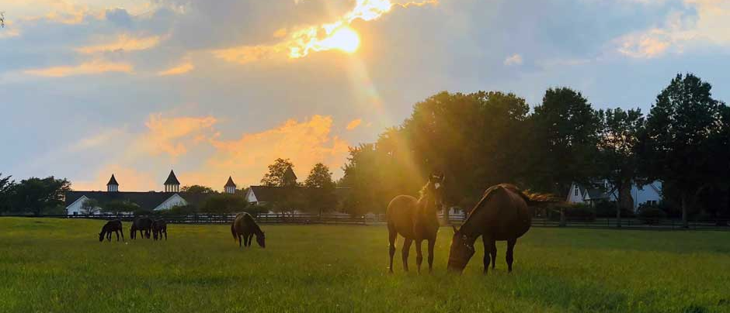
New Jersey Sire Stakes
BREEDERS GUIDE

Slide 2
Tattoo Artist p,5,1:47.1 ($2,526,058)
STANDING AT DEO VOLENTE FARM deovolentefarms.com
2024 Fee $10,000

Slide 3
Perfect Sting Pacer 3, 1:48.1M ($1,808,147) Always B Miki-Shebestingin-Bettor’s Delight Two Time Breeders Crown Champion 2020 ( 2 year old) 2021 ( 3 year old). Leading Purse Money Earner in 2021 with earnings of $1,273,847. He was named the Dan Patch 2 year old pacer of the year in 2020
STANDING AT DEO VOLENTE FARM www.deovolentefarms.com
2024 Fee $10,000

Slide 4
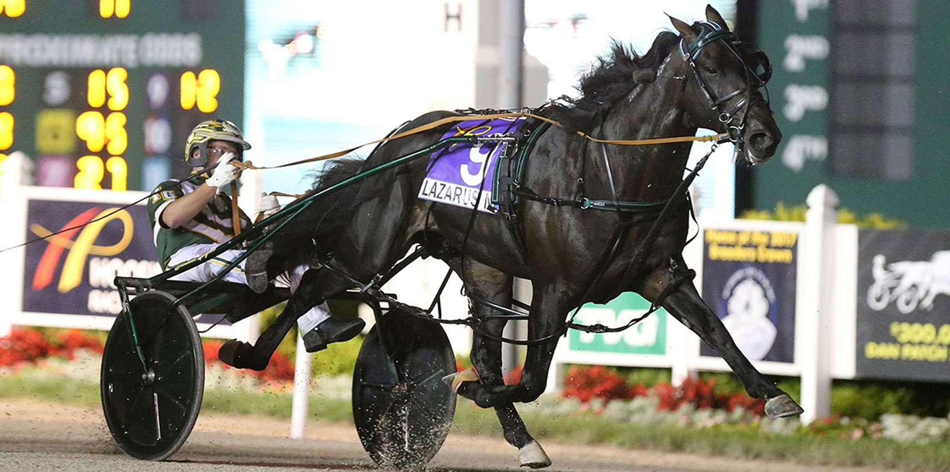
Lazarus N Pacer Q1:48.3 BT1:46.3 - $3,070,095 Named New Zealand Horse of the Year twice, three-year-old Pacer of the Year, four-year-old Pacer of the Year and five-year-old Pacer of the Year.
STANDING AT DEO VOLENTE FARM www.deovolentefarms.com
2024 Fee $5,000

Slide 5
Ecurie D DK ($1,514,969) Infi6, 1:49.1M Infinitif - To Soon - Muscles Yankee In May of 2022, in his first start of the year, he won the Cutler Memorial at the Meadowlands in 1:49.1 – a world record and the fastest mile ever trotted in May in harness racing history.
STANDING AT SOUTHWIND FARM www.southwindfarms.net
2024 Fee - $10,000

Slide 6
Muscle Hill 2, 1:53.3, 3, 1:50.1-'09 ($3,266,835) Muscles Yankee – Yankee Blondie – American Winner The #1 trotting sire, he led in all-age money-earnings again in 2020, with the winners of over $9.6-million. He has been the leading sire for the fifth year in a row, from 2016 to 2020.
STANDING AT SOUTHWIND FARM www.southwindfarms.net
Private Treaty

Slide 7
Tactical Landing 3, 1:50.2M ($812,300) Bay 2015 • Muscle Hill - Southwind Serena – Varenne In 2018 at three, winner of his elimination and $500,000 Final of the Breeders Crown, the $350,000 TVG Trot Final, Bluegrass Stakes, an elimination of the Hambletonian, an elimination of the Kentucky Futurity, and a leg of the Kentucky Sires Stakes.
STANDING AT SOUTHWIND FARM www.southwindfarms.net
2024 Fee $15,000

Slide 8
Walner 3, 1:50.2M ($567,652)Bay 2014 • Chapter Seven – Random Destiny - Ken Warkentin
A winner of 9 of 10 career starts, including 7 of 8 at two, highlighted by the Breeders Crown (elim and Final), Kindergarten Final
and the International Stallion Stake at The Red Mile, trotting to his two-year-old World Record of 2,1:51.3.
STANDING AT SOUTHWIND FARM www.southwindfarms.net
2024 Book Full and Closed

Slide 9
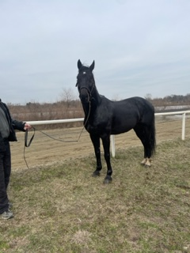
Sunken Treasure
Somebeachsomewhere - Fastidious Hanover – Life Sign
2013 , P, 3, 1:52. $256,035
STANDING AT LEFT A MILLION FARM
28235 Gaunts Bridge Farm
Columbus, New Jersey 08022
609-752-2550

Slide 10
Mysterious Moment Totally Western – Lover’s Talk – Life Sign 2006 , P, 10, 1:51.0M $471,887 #1 leading money winner of his sire Totally Western. He is also the fastest offspring with a beaten time of 1:49.3
Frank Lomangino njiceking@aol.com 732-922-0852

